Slide 1
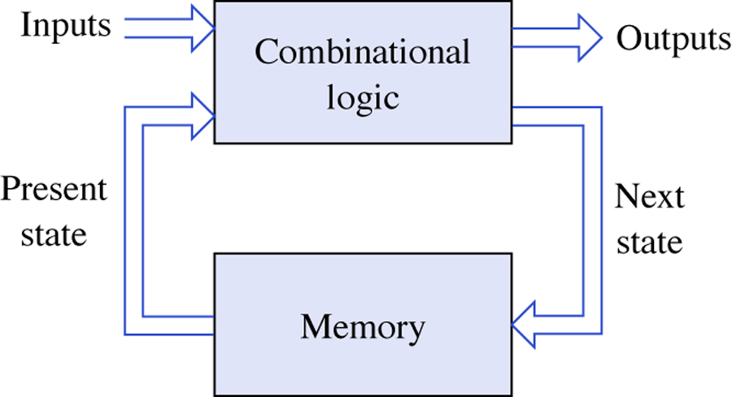
Copyright © The McGraw-Hill Companies, Inc. Permission required for reproduction or display.
General model of a sequential network.
Figure 7.1
7-<number>

Slide 2
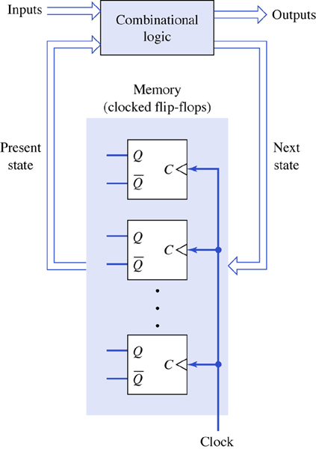
Structure of a clocked synchronous sequential network.
Figure 7.2

Slide 3
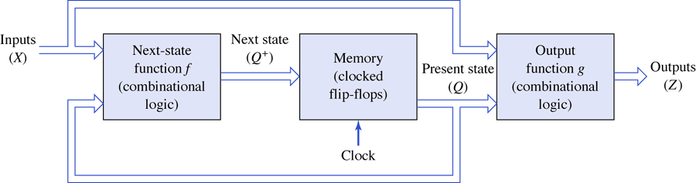
Mealy model of a clocked synchronous sequential network.
Figure 7.3

Slide 4
The next state function Q+
O* = f(X,Q)
Similarly, if Z is regarded as the collective output signals of the network, then under the assumption that the outputs are a function of both the inputs and present state, it immediately follows that
Z= g(X,Q)

Slide 5
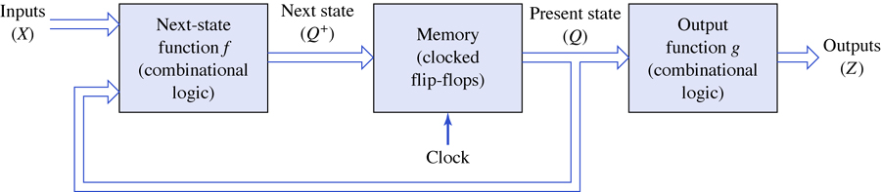
Moore model of a clocked synchronous sequential network.
Figure 7.4

Slide 6
The next state function Q+
O* = f(X,Q)
Similarly, if Z is regarded as the collective output signals of the network, then under the assumption that the output is a function of only the present state, it immediately follows that
Z= g(Q)

Slide 7
Differences between mealy and moore models
Moore Machine | Mealy Machine
Output depends only upon the present state. | Output depends on the present state as well as present input.
Moore machine also places its output on the transition. | Mealy Machine places its output on the transition.
More states are required. | Less number of states are required.
There is less hardware requirement for circuit implementation. | There is more hardware requirement for circuit implementation.
They react slower to inputs(One clock cycle later). | They react faster to inputs.
Synchronous output and state generation. | Asynchronous output generation.
Output is placed on states. | Output is placed on transitions.
Easy to design. | It is difficult to design.
If input changes, output does not change | If input changes, output also changes.
Has more or the same states as that of the Mealy machine. | Has fewer or the same states as that of the Moore machine.

Slide 8
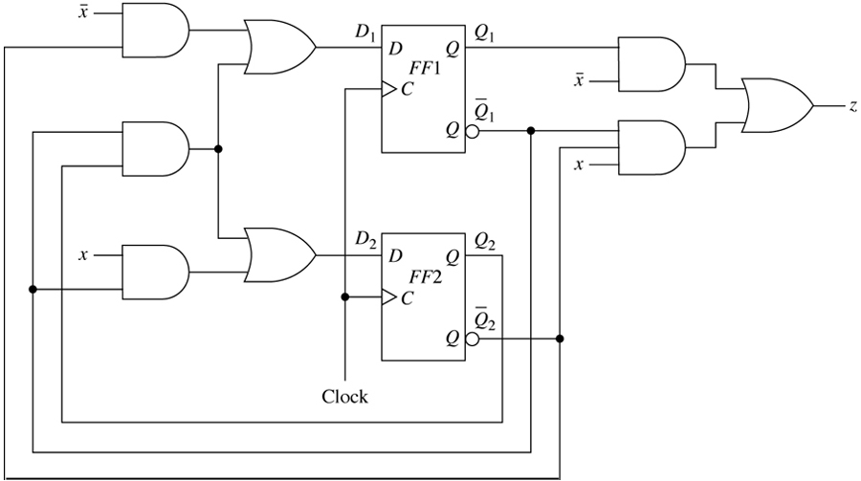
Logic diagram for Example 7.1.
Figure 7.5

Slide 9
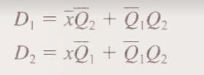

The excitations to the flip-flops of the previousnFig. correspond to the logic values that appear at the D input terminals of flip-flops FF 1 and FF2. Algebraically,
To complete the algebraic description of a sequential network, it is also necessary to write algebraic expressions for the network outputs. the output is given by

Slide 10

For D flip flop
Q+=D, the transition equations for this circuit would be:
Q; =D1
Q2+=D2
Substituting

Slide 11
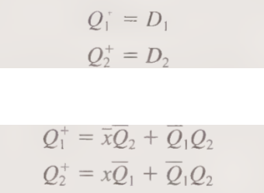
Transition table and equations

Slide 12
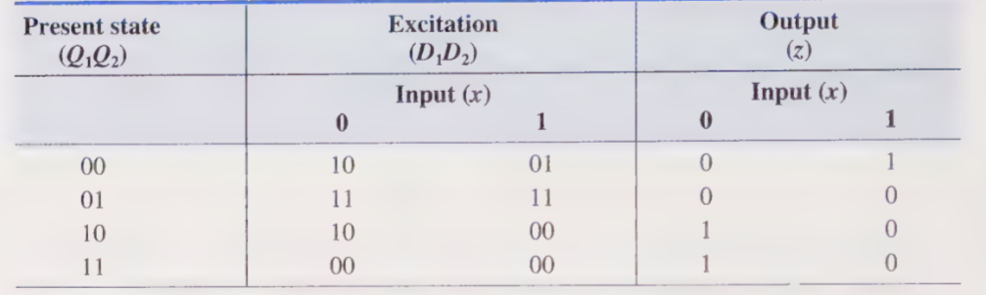
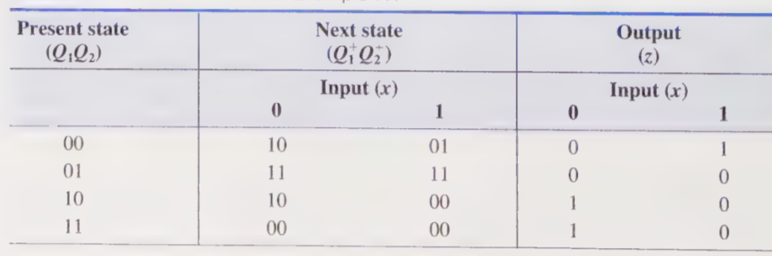

Slide 13
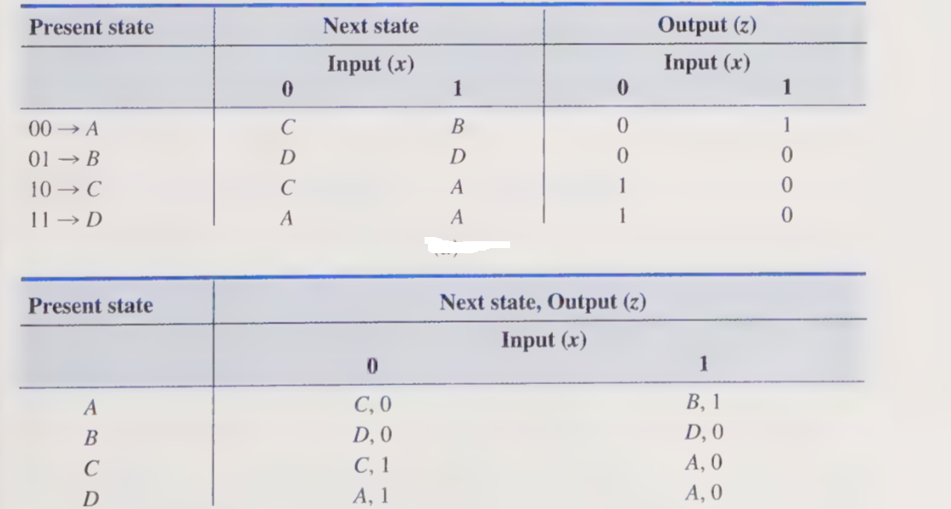
State table

Slide 14
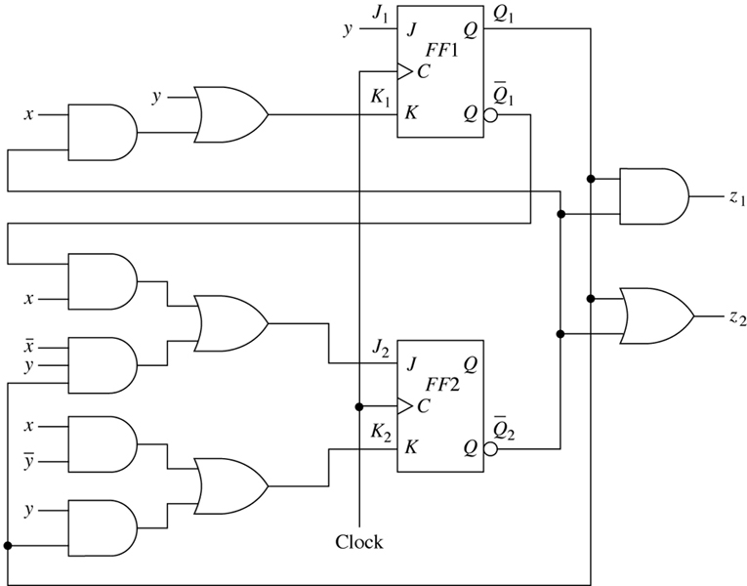
Logic diagram for Example 7.2.
Figure 7.6

Slide 15
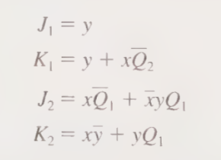

The excitation equations are as follows:

Slide 16
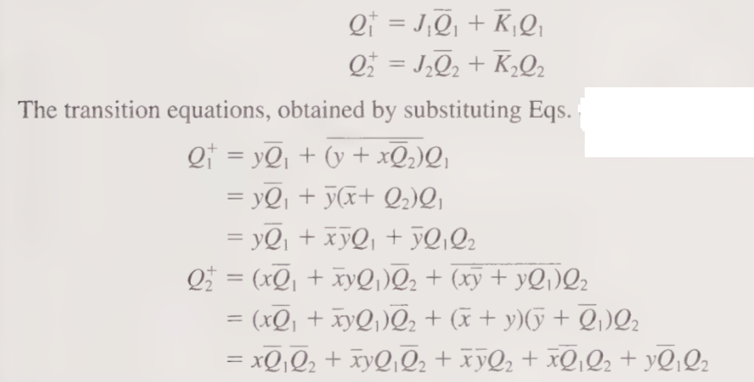
Characteristic equation for a JK flip-flop is
O+=JQ’+K’Q

Slide 17
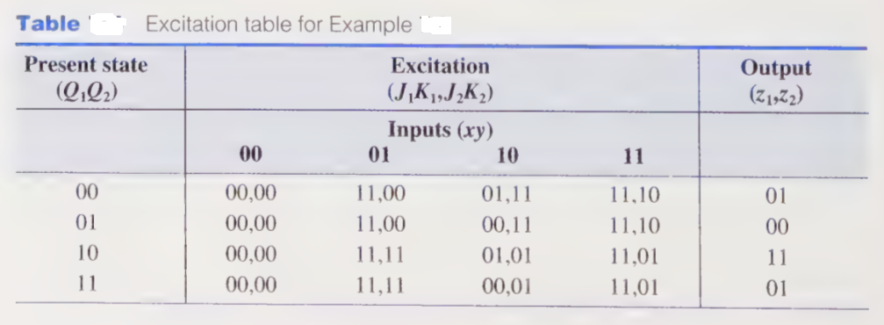

Slide 18
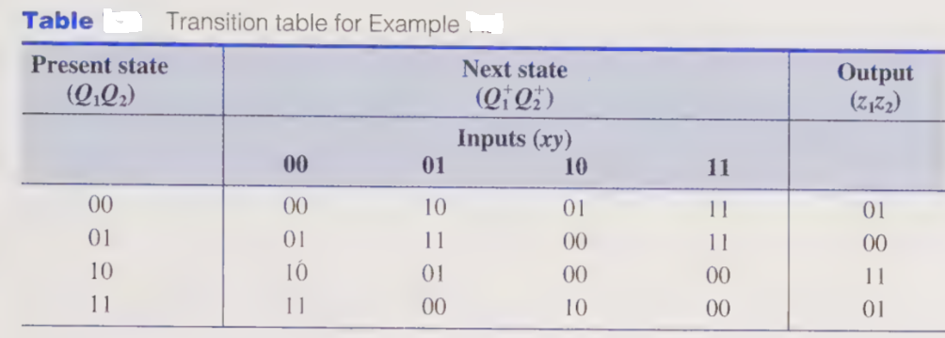

Slide 19
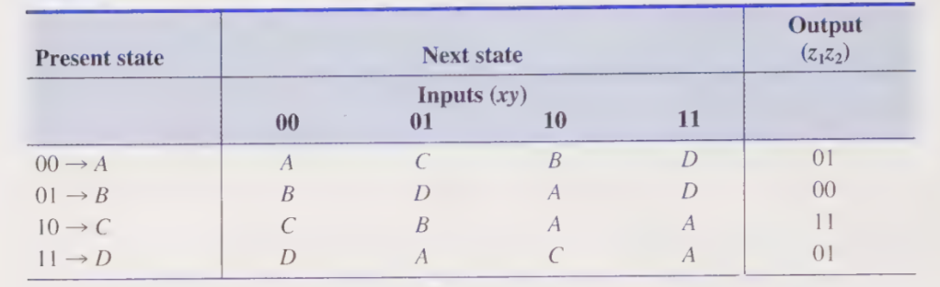
State table

Slide 20
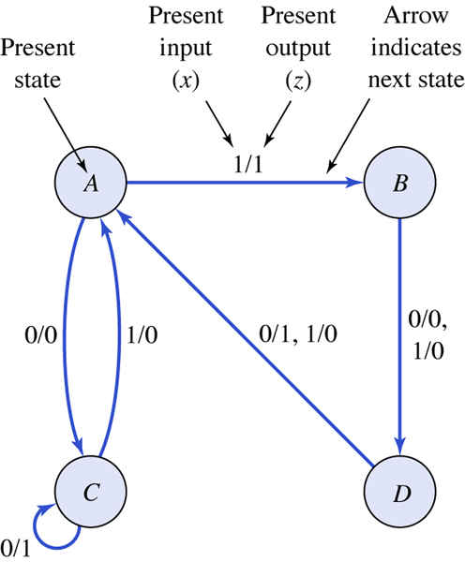
State diagram for Example 7.1.
Figure 7.7

Slide 21
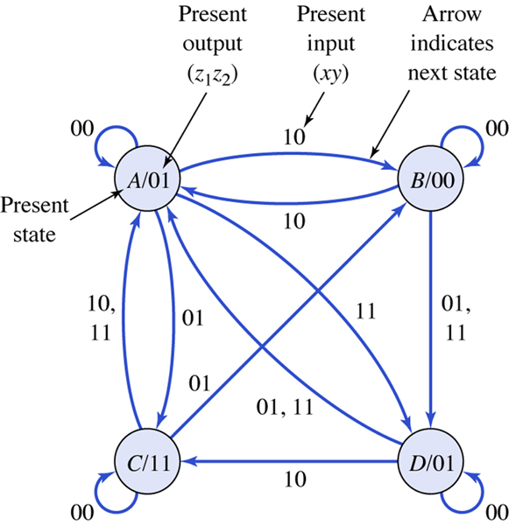
State diagram for Example 7.2.
Figure 7.8

Slide 22
Assume the flip-flops are both in their 0-states, which corresponds
to state A, and the input sequence x = 0011011101 1s applied to the network.* From the general discussion on the operation of clocked
synchronous sequential networks, the inputs are assumed to be applied prior to the triggering time of the clock signal that can affect a state transition, and the effects of the inputs have propagated through the combinational logic so that final values appear at the network outputs and flip-flop inputs.
Therefore, according to Tables it is seen that when the first x = 0 input is applied to the network when in state A, the network produces a z = 0 output.
Furthermore, upon receipt of the positive edge of the clock signal, the memory portion of the network goes to state C. Next, another x = 0 is applied. Since the network is now in state C, a current output of | is produced and the network remains in state C upon receipt of the next positive edge of the clock signal. It can readily be checked that the input sequence x = 0011011101 applied to the network of Example 7.1 when initially in state A produces the following state andoutput sequences:

Slide 23
Input sequencex = 0011011101
State sequence = ACCABDABDAB
Output sequencez =O 107001011

Slide 24
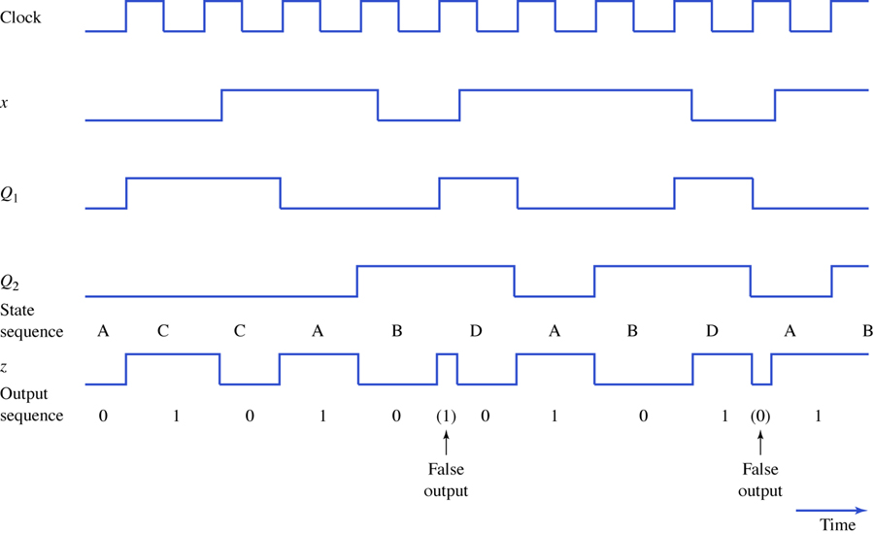
Timing diagram for Example 7.1.
Figure 7.9

Slide 25
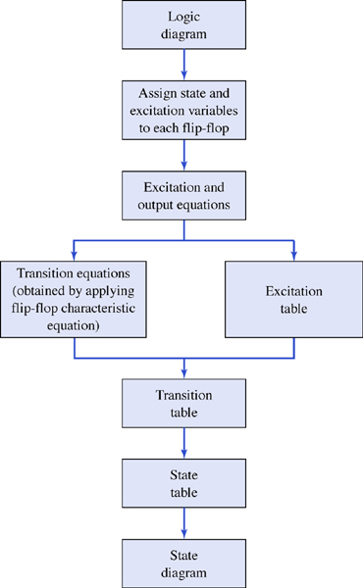
The analysis procedure.
Figure 7.10

Slide 26
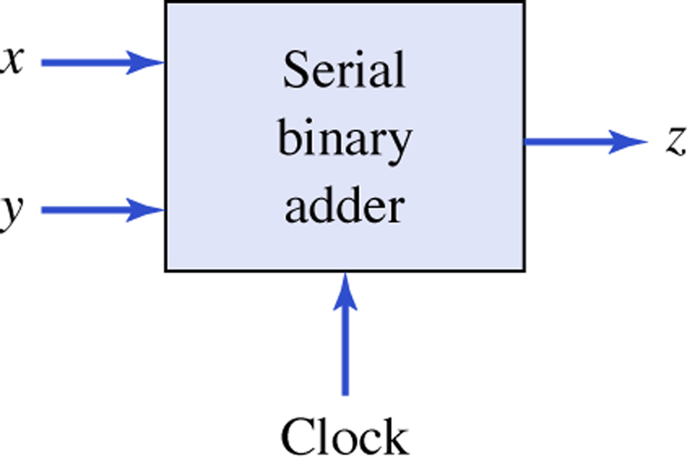
The serial binary adder.
Figure 7.11

Slide 27
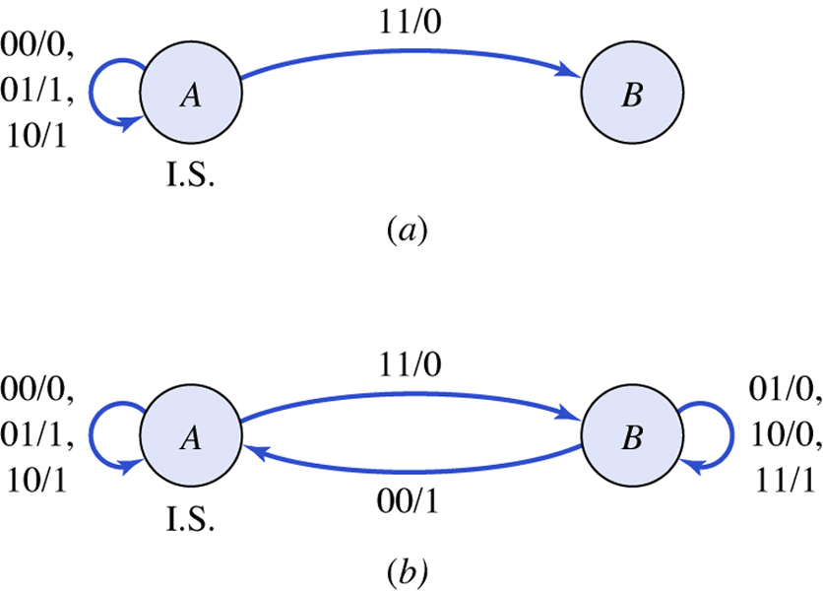
Obtaining the state diagram for a Mealy serial binary adder. (a) Partial state diagram. (b) Completed state diagram.
Figure 7.12

Slide 28
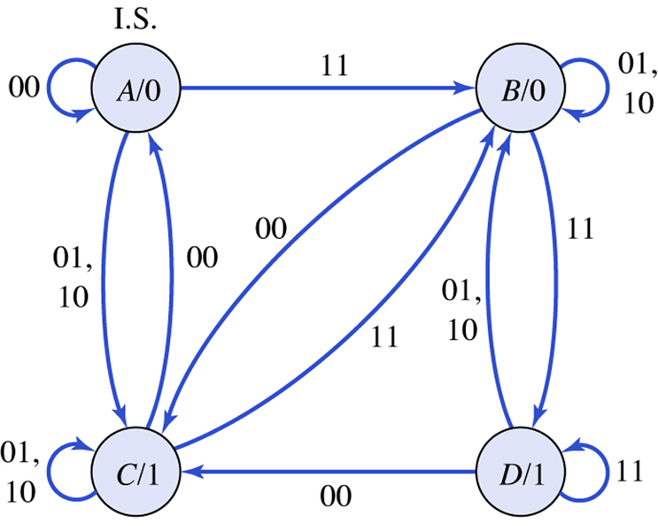
State diagram for a Moore serial binary adder.
Figure 7.13

Slide 29
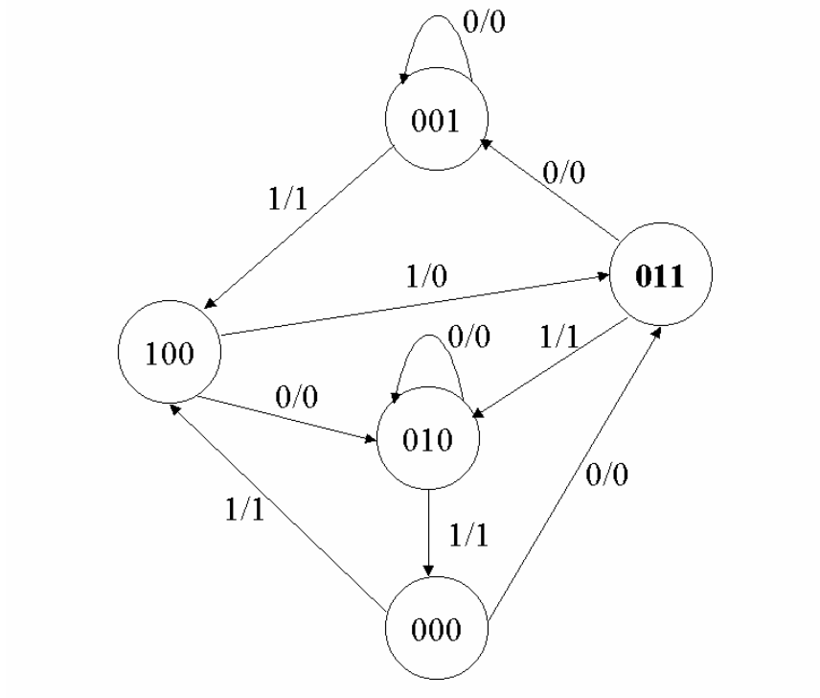
A sequential circuit has three flip-flops A, B, C; one input x; and one output, y. The state diagram is shown in Fig.below. The circuit is to be designed by treating the unused states as don’t-care conditions. Analyze the circuit obtained from the design to determine the effect of the unused states.
i) Use D flipflops ii) Use JK flipflops

Slide 30
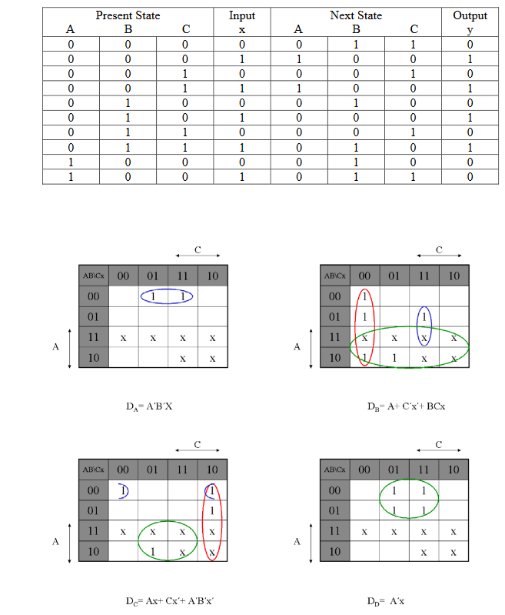

Slide 31
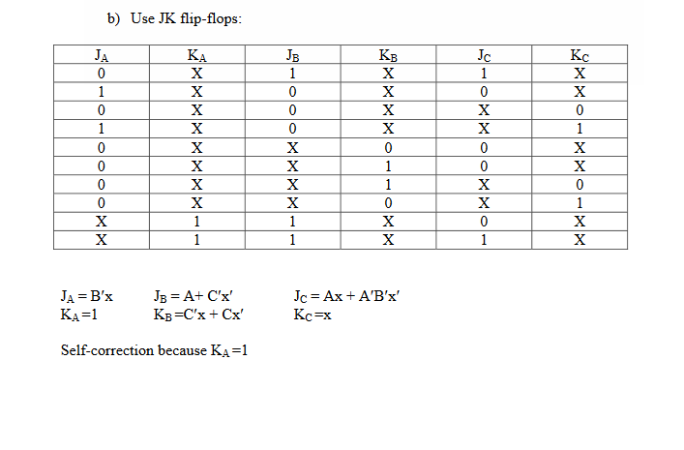

Slide 32
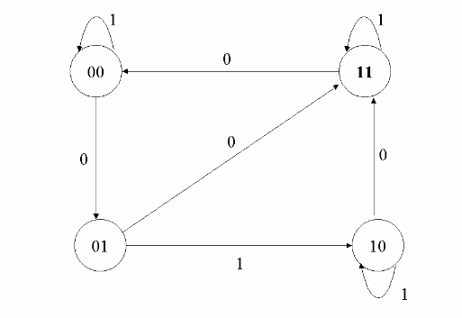
Design the sequential circuit specified by the state diagram for the figure below usingT flip-flops

Slide 33
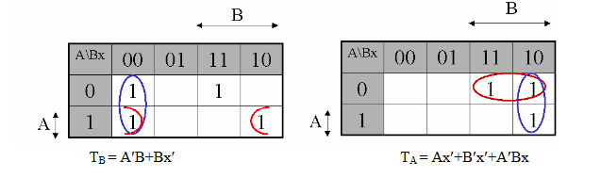
Draw the state table
TA (A, B, x) = ∑ ( 2, 3, 6)
TB (A, B, x) = ∑ ( 0, 3, 4, 6)

Slide 34
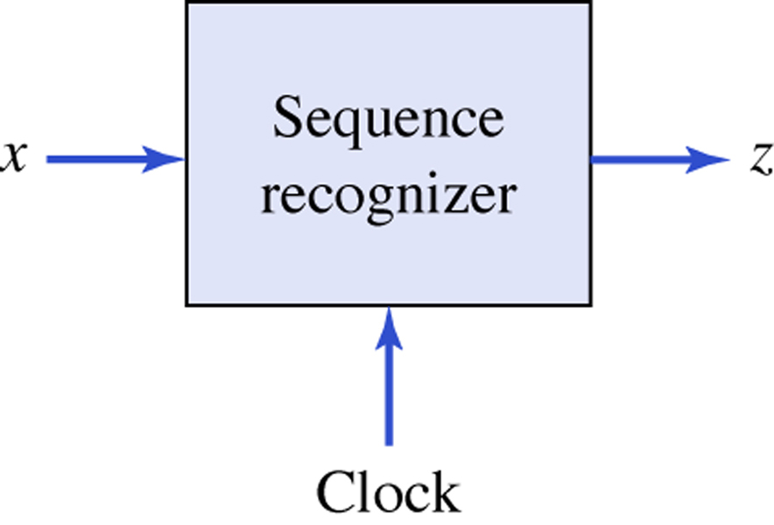
A sequence recognizer.
Figure 7.14

Slide 35
x=0100010010010010000000011'
z=0000001000000100000000001

Slide 36
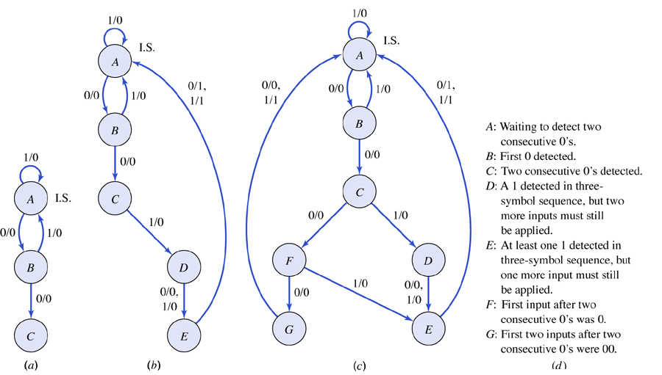
State diagram for a sequence recognizer. (a) Detection of two consecutive 0’s. (b) Partial analysis of the
three-symbol sequence. (c) Completed state diagram. (d) Definition of states.
Figure 7.15

Slide 37


Slide 38
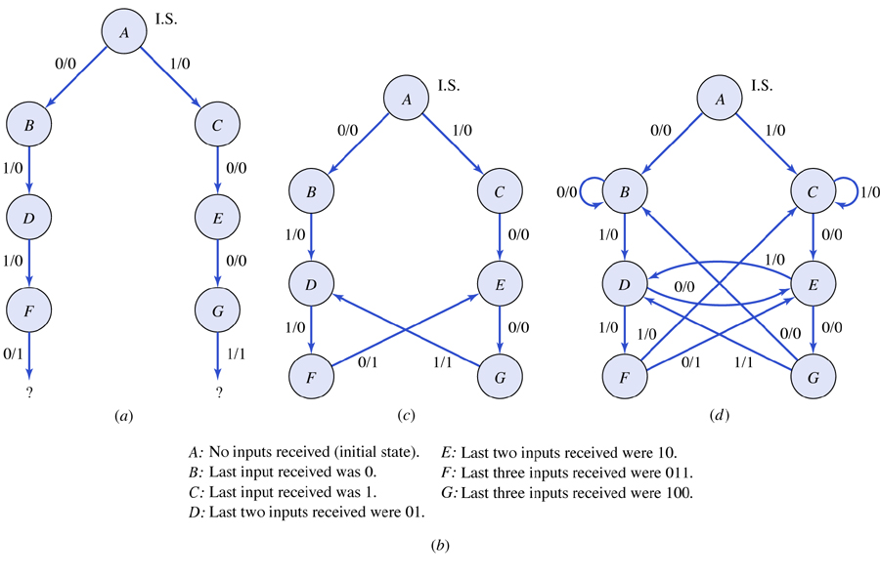
A 0110/1001 sequence recognizer. (a) Beginning the detection of the sequences 0110 or 1001. (b) Definition of states. (c) Completing the detection of the two sequences 0110 or 1001. (d) Completed state diagram.
Figure 7.16

Slide 39
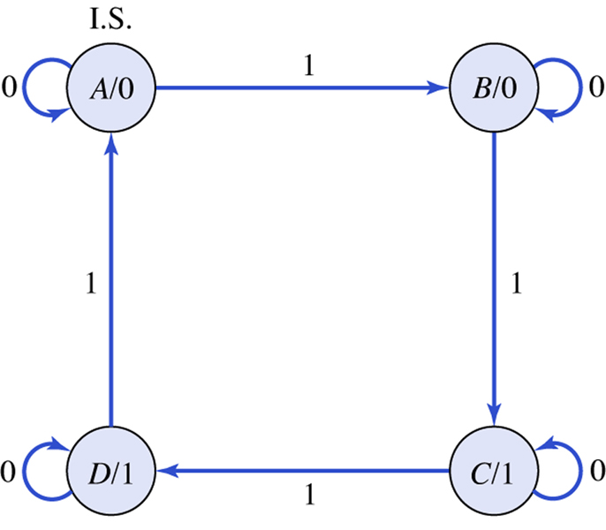
State diagram for the final example.
Figure 7.17

Slide 40
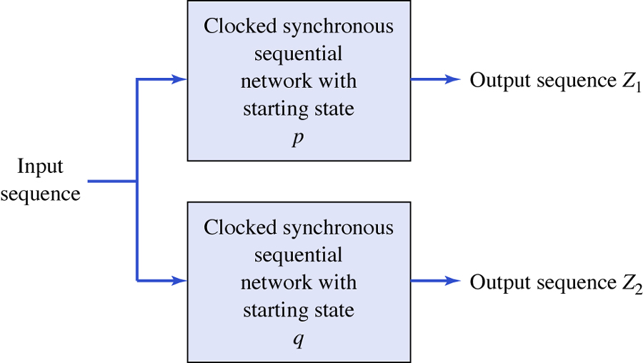
Experiment for determining equivalent pairs of states.
Figure 7.18

Slide 41
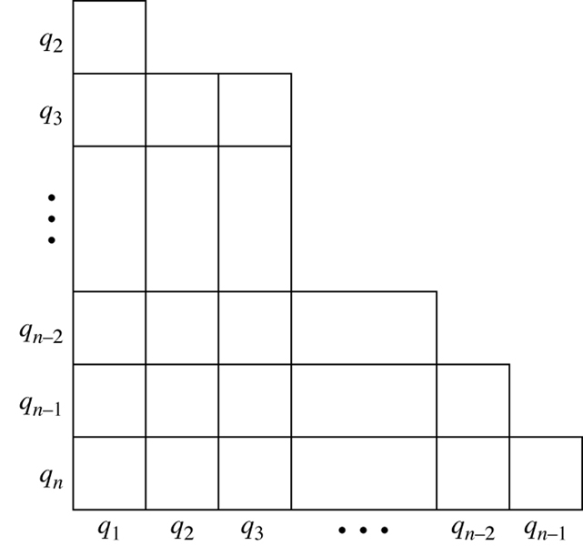
The structure of an implication table.
Figure 7.19

Slide 42
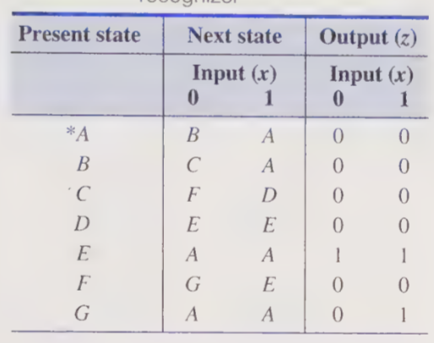

Slide 43
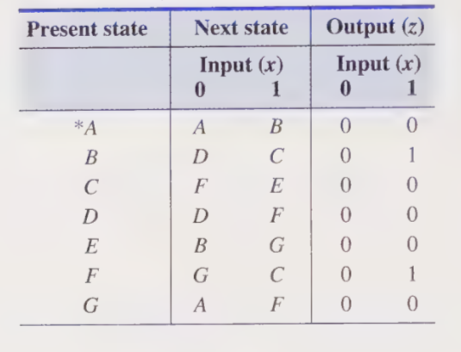

Slide 44
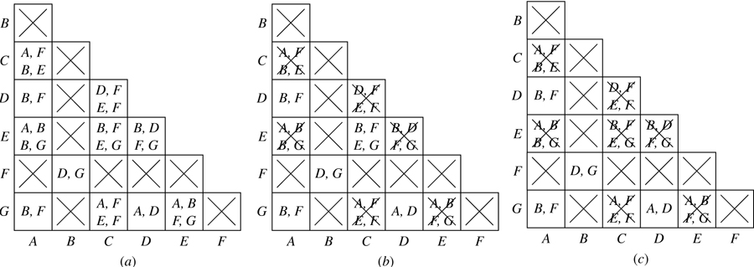
Implication table for determining the equivalent states of Table 7.13. (a) The initial table. (b) After the first pass. (c) After the second pass.
Figure 7.20

Slide 45
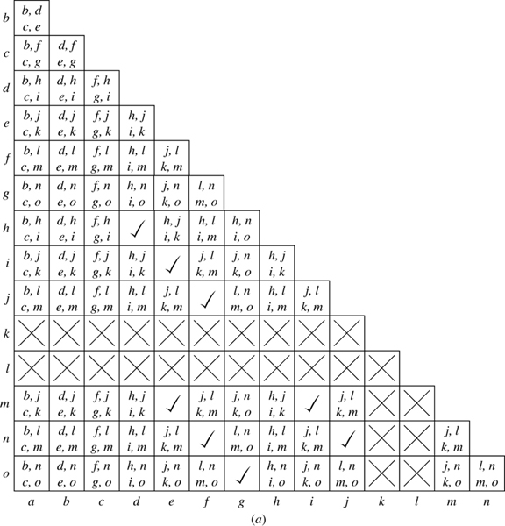
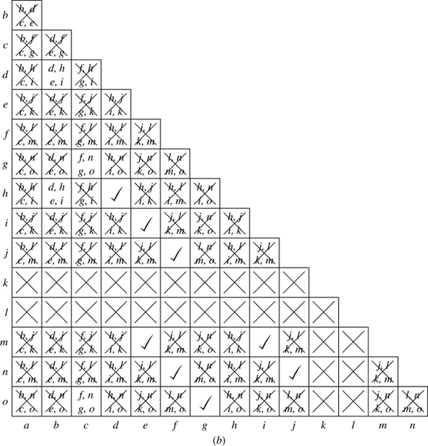
Implication table for determining equivalent states of the 0110/1001 sequence recognizer. (a) Initial table.
(b) Final table.
Figure 7.21

Slide 46
State assignment rules/guidelines
Define two states as being adjacent if their binary codes differ in exactly one bit.
Similarly, two input combinations are considered adjacent if they differ in exactly one bit. The following rules suggest which states should be made adjacent in an attempt to obtain simple Boolean expressions for the next-state and output functions.

Slide 47
Rule I: Two or more present states that have the same next state for a given input combination should be made adjacent.
Rule II: For any present state and two adjacent input combinations, the two next states should be made adjacent.
Rule III: Two or more present states that produce the same output symbol, i.e., 0 or 1, for a given input combination should be made adjacent. This rule need only be applied to one of the output symbols.

Slide 48
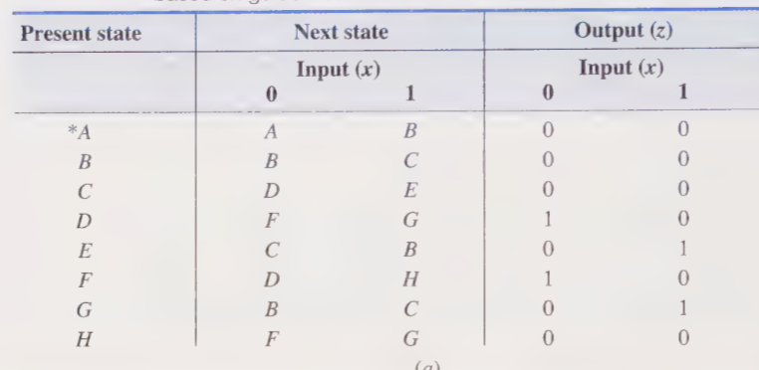

Slide 49
It is noted that state B is the next state for both present states B and G when the input is x = 0. Rule I suggests that states B and G should have adjacent codes. Similarly, for the same input, states C and F should be coded as ad- jacent states since their next states are both state D, and states D and H should be coded as adjacent states since their next states are both state F. Referring to the column for x = 1, it is concluded that the pairs of states (A,E), (B,G), and (D,H) should each be coded as adjacent states.
To summarize, Rule I proposes the following adja-cency conditions should be attempted:
Rule I: (B,G)(2X), (C,F), (D,H)(2X), (A,E£)
The (2) following the pairs (B,G) and (D,A) indicates that the recommended adjacency conditions appear twice and should be given higher priority than those that appear only once.

Slide 50
Next consider Rule II. Since x = 0 and x = | are adjacent input
combinations, the next-state pair for each present state should be made adjacent according to Rule II. Thus, Rule II recommends the following state adjacencies:
Rule II: (A,B), (B,C)(3X), (D,E), (F,G)(2X), (D,A)
Finally, in an attempt to group the | entries in the output map, Rule III proposes the
following pairs of states should be adjacent:
Rule III: (D,F), (E,G)

Slide 51
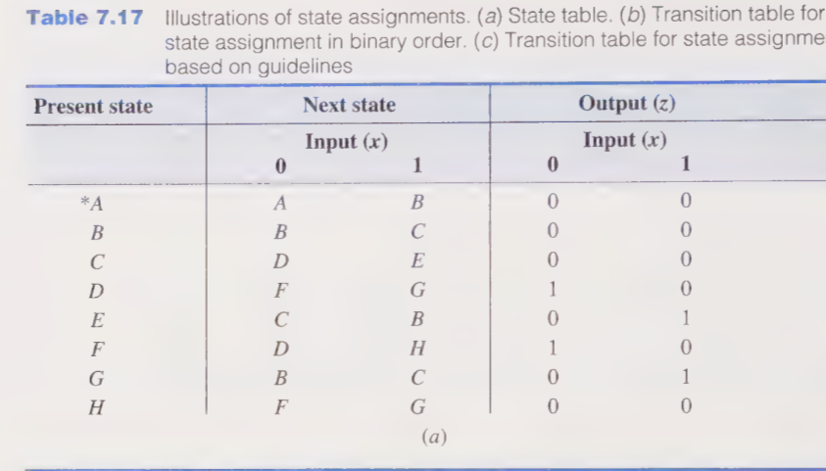

Slide 52
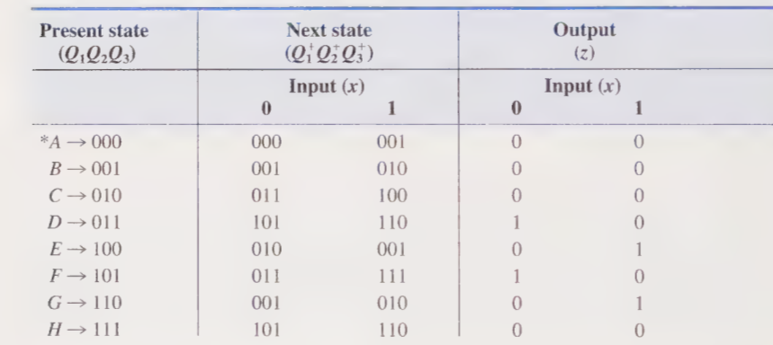

Slide 53
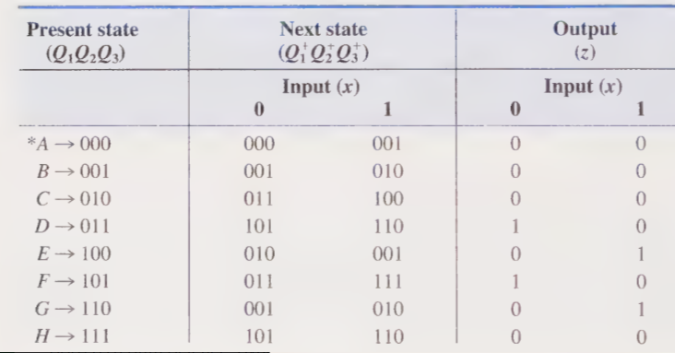

Slide 54
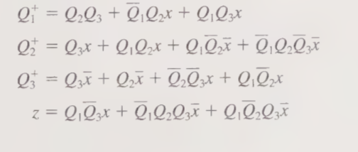

Slide 55
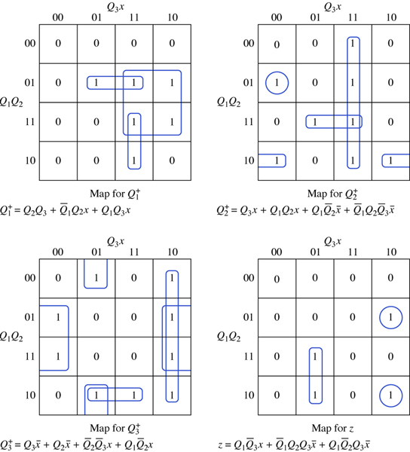
Next-state and output Karnaugh maps for the transition table of Table 7.17b.
Figure 7.22

Slide 56
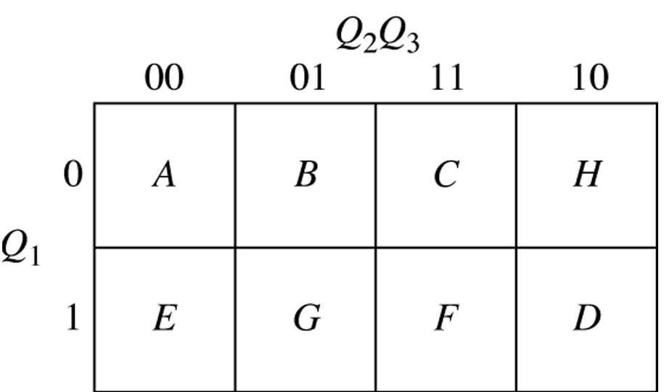
A state-assignment map for the state table of
Table 7.17a.
Figure 7.23

Slide 57
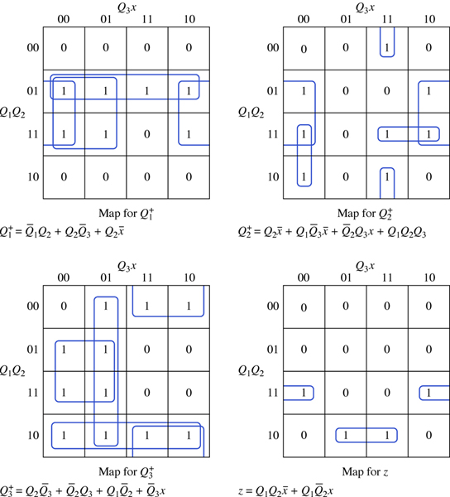
Next-state and output Karnaugh maps for the transition table of Table 7.17c.
Figure 7.24

Slide 58
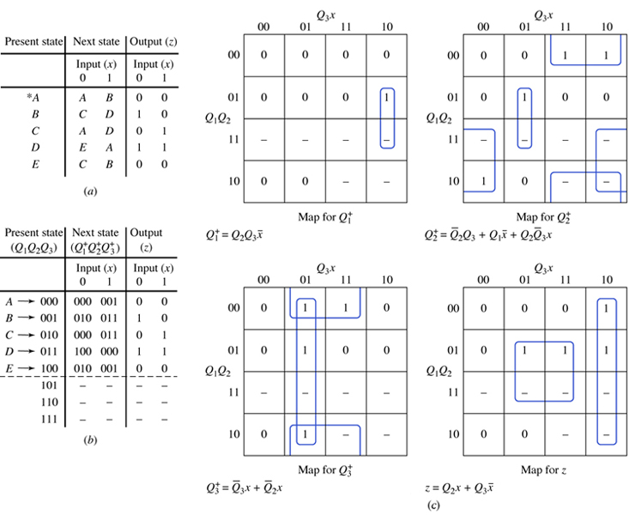
Two approaches to handling unused states. (a) State table. (b) Transition table with don’t-cares for unused states. (c) Next-state maps, output map, and expressions for table of Fig. 7.25b.
Figure 7.25

Slide 59
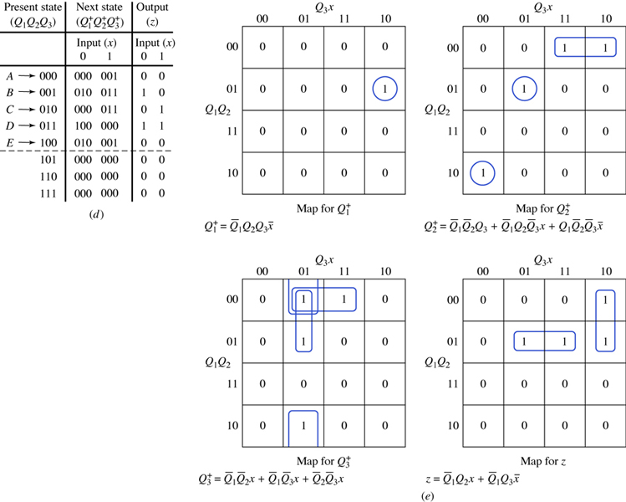
(d) Transition table when unused states cause the network
to go to state A. (e) Next-state maps, output map, and
expressions for table of Fig. 7.25d.
Figure 7.25 cont.

Slide 60
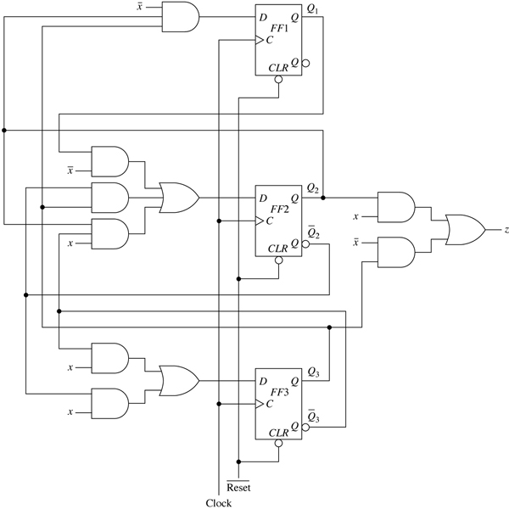
Logic diagram for the excitation table of Table 7.19.
Figure 7.26

Slide 61

Excitation and output maps for the excitation table of Table 7.20.
Figure 7.27

Slide 62

Logic diagram for the excitation table of Table 7.20.
Figure 7.28

Slide 63

Excitation and output maps for the Moore serial binary adder.
Figure 7.29

Slide 64

Logic diagram for the Moore serial binary adder.
Figure 7.30

